Slide 1









Welcome to class 6A4

Slide 2



Stop the bus

Slide 3


Everest
Stop the bus
The highest mountain in the world

Slide 4
Ha Long
Stop the bus
One of the beautiful nature wonders in Viet Nam

Slide 5
Loch Lomond
Stop the bus
The largest freshwater lake in Britain

Slide 6
Ayres
Stop the bus
A red rock in Australia

Slide 7
Sahara
Stop the bus
The hottest desert in the world

Slide 8


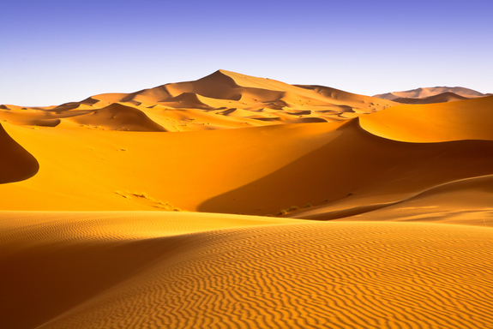
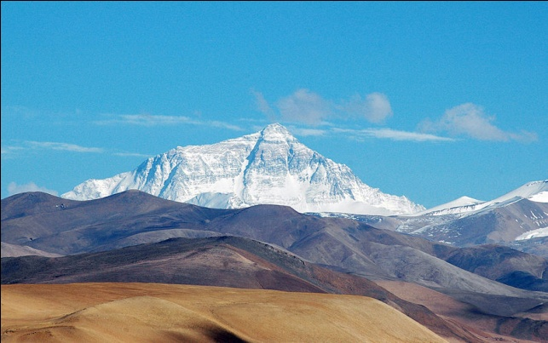
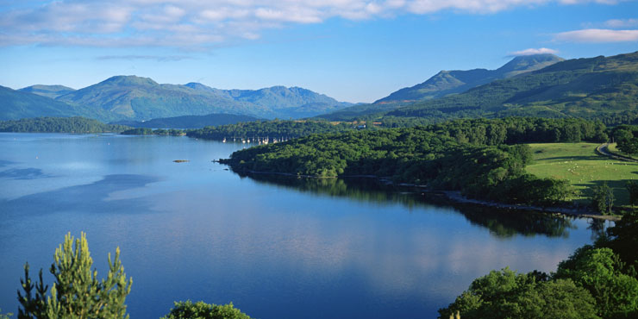
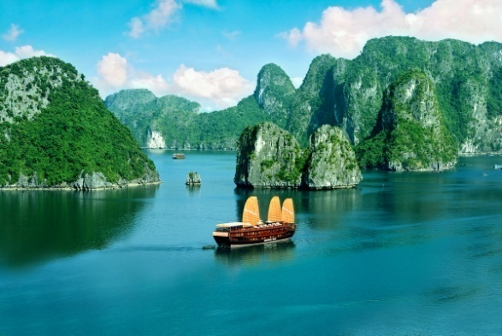
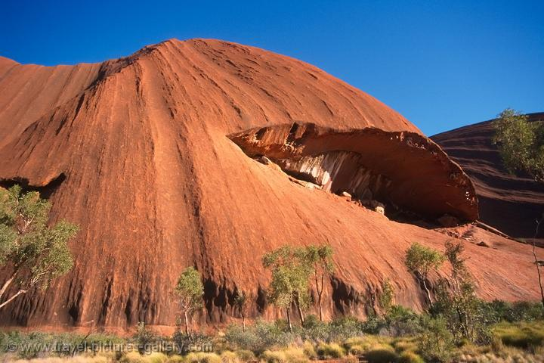
PERIOD 40
UNIT 5 - NATURAL WONDERS
LESSON 7: Looking back and Project

Slide 9
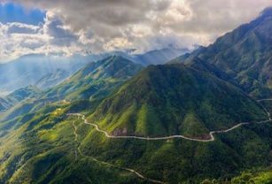
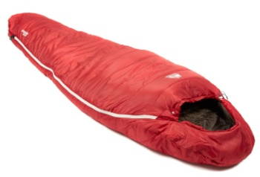


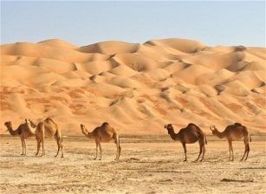
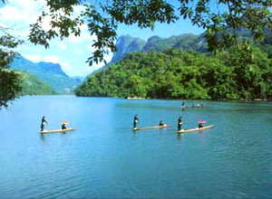


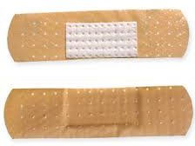

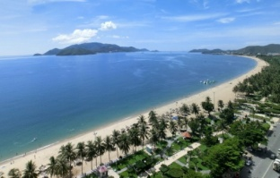

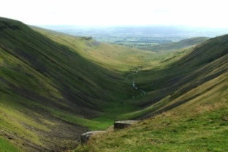
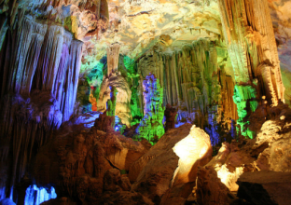

WHAT AND WHERE
1
2
3
4
5
6
7
8
9
10
11
12
13
15
14

Slide 10
WHAT AND WHERE
3
1
2
6
4
5
9
7
8
15
10
11
12
14
13

Slide 11
WHAT AND WHERE
1
2
3
4
5
mountain
sleeping bag
forest
painkillers
desert
6
7
8
9
10
plasters
sissors
lake
water fall
compass
11
12
13
15
14
beach
torch
valley
cave
island

Slide 12
SUPERLATIVE ADJECTIVE
Form: Adj + est

Slide 13
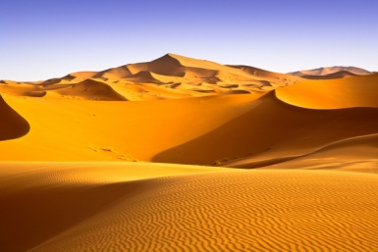
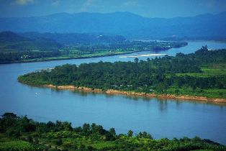
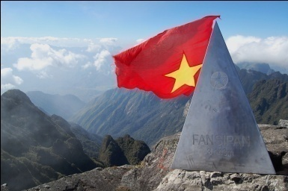
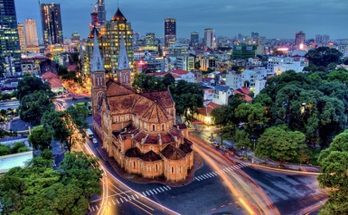
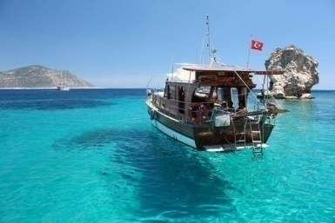
COMPLETE THE SENTENCES
hottest
(hot)
1. It’s the ……….. desert in the world.
2. The Mekong is the ……….. river in Viet Nam.
3. Fansipan is the ……….. mountain in Viet Nam.
4. Ho Chi Minh City is the ……….. city in Viet Nam.
5. The boat trip was the ……….. experience of my life.
longest
(long)
(high)
highest
(large)
largest
(good)
best

Slide 14
MODAL VERB “MUST”
GIVE ORDERS AND TRAVEL ADVICE

Slide 15

R
L
P
A
O
E
L
Y

Slide 16
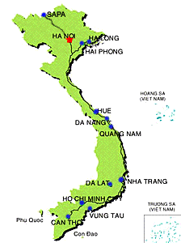

P
O
E
T
R
J
C
How well do you know about Viet Nam?

Slide 17

A MUSICAL CHAIR
RULES
Have 6 questions about:
the weather, travelling and natural attractions.
The student in front of the chair after stopping the music will have a right to choose and answer a question.
Each right answer is given a flower.

Slide 18


WEATHER
TRAVELLING
1
2
1
2
NATURAL ATTRACTIONS
1
2

Slide 19

PART TWO
T
L
N
S
O
A
E
T
H
W
Draw a map of Viet Nam and write information on it to create a classroom display.

Slide 20
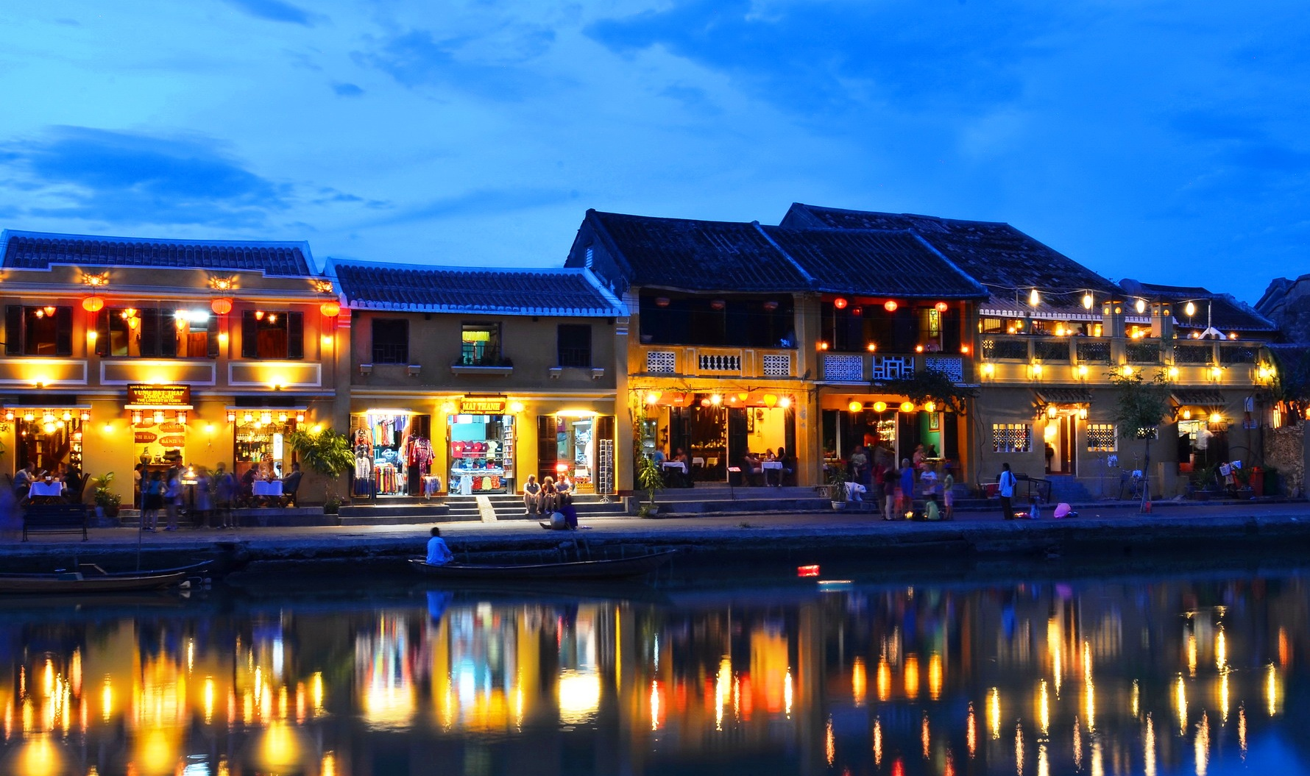
T
L
S
O
A
K
H
W

Slide 21

T
L
S
O
A
K
H
W

Slide 22

Revise the new words and grammar.
Write an entry about an interesting place.
Prepare Revision .

Slide 23
Best wishes to all of you.
Good bye. See you soon.

Slide 24

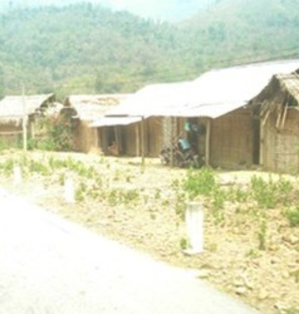
What is the hottest place in Viet Nam?
Tuong Duong, in Nghe An

Slide 25
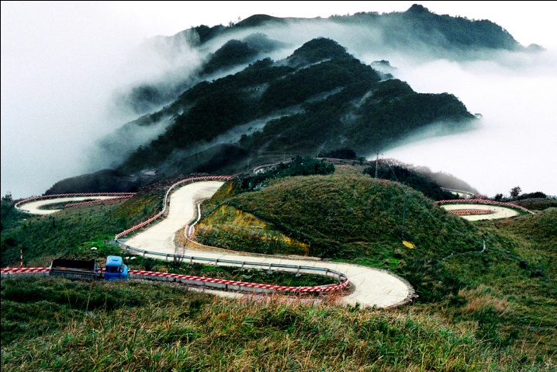
What is the coldest place in Viet Nam?
Mau Son, in Lang Son

Slide 26
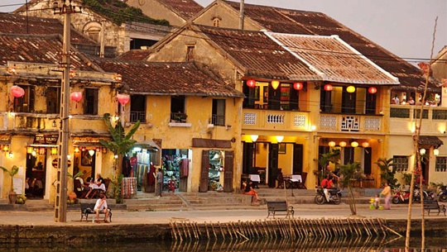
What is the oldest city in Viet Nam?
Hoi An, Quang Nam

Slide 27

What is the fastest way to travel around Viet Nam?
It’s by plane

Slide 28

What is the longest river in Viet Nam?
Mekong river

Slide 29
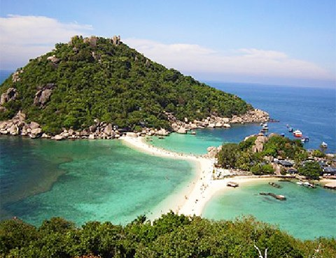
What is the biggest island in Viet Nam?
Phu Quoc. In Kien Giang

